Slide 1
Tracker Camera
Abel Amadou
Benjamin Boudra
Dean Bailey
Jalen Halverson
John Qualls
Joshua Dixie
Shelley King

Slide 2
What is Tracker Camera?
Automated tracking video recording mobile application.
Cheaper alternative
Users
Athletics
Academics
YouTube

Slide 3
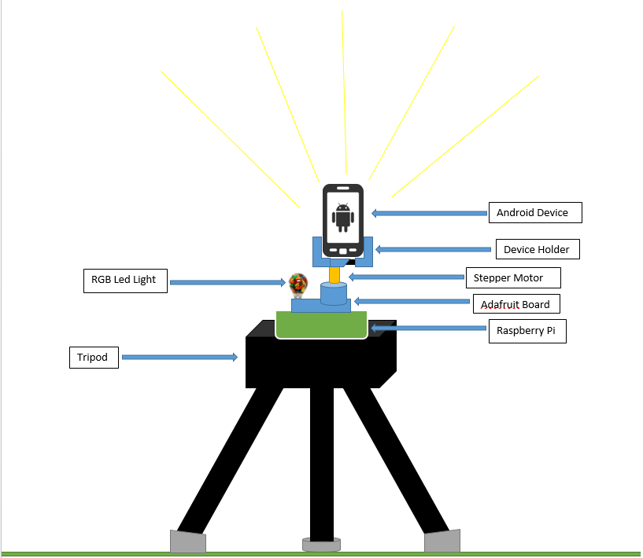
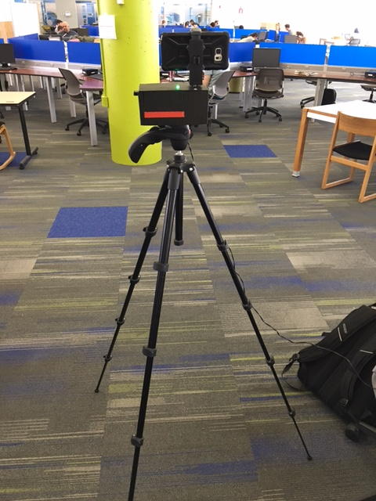
Initial Design vs. Prototype

Slide 4
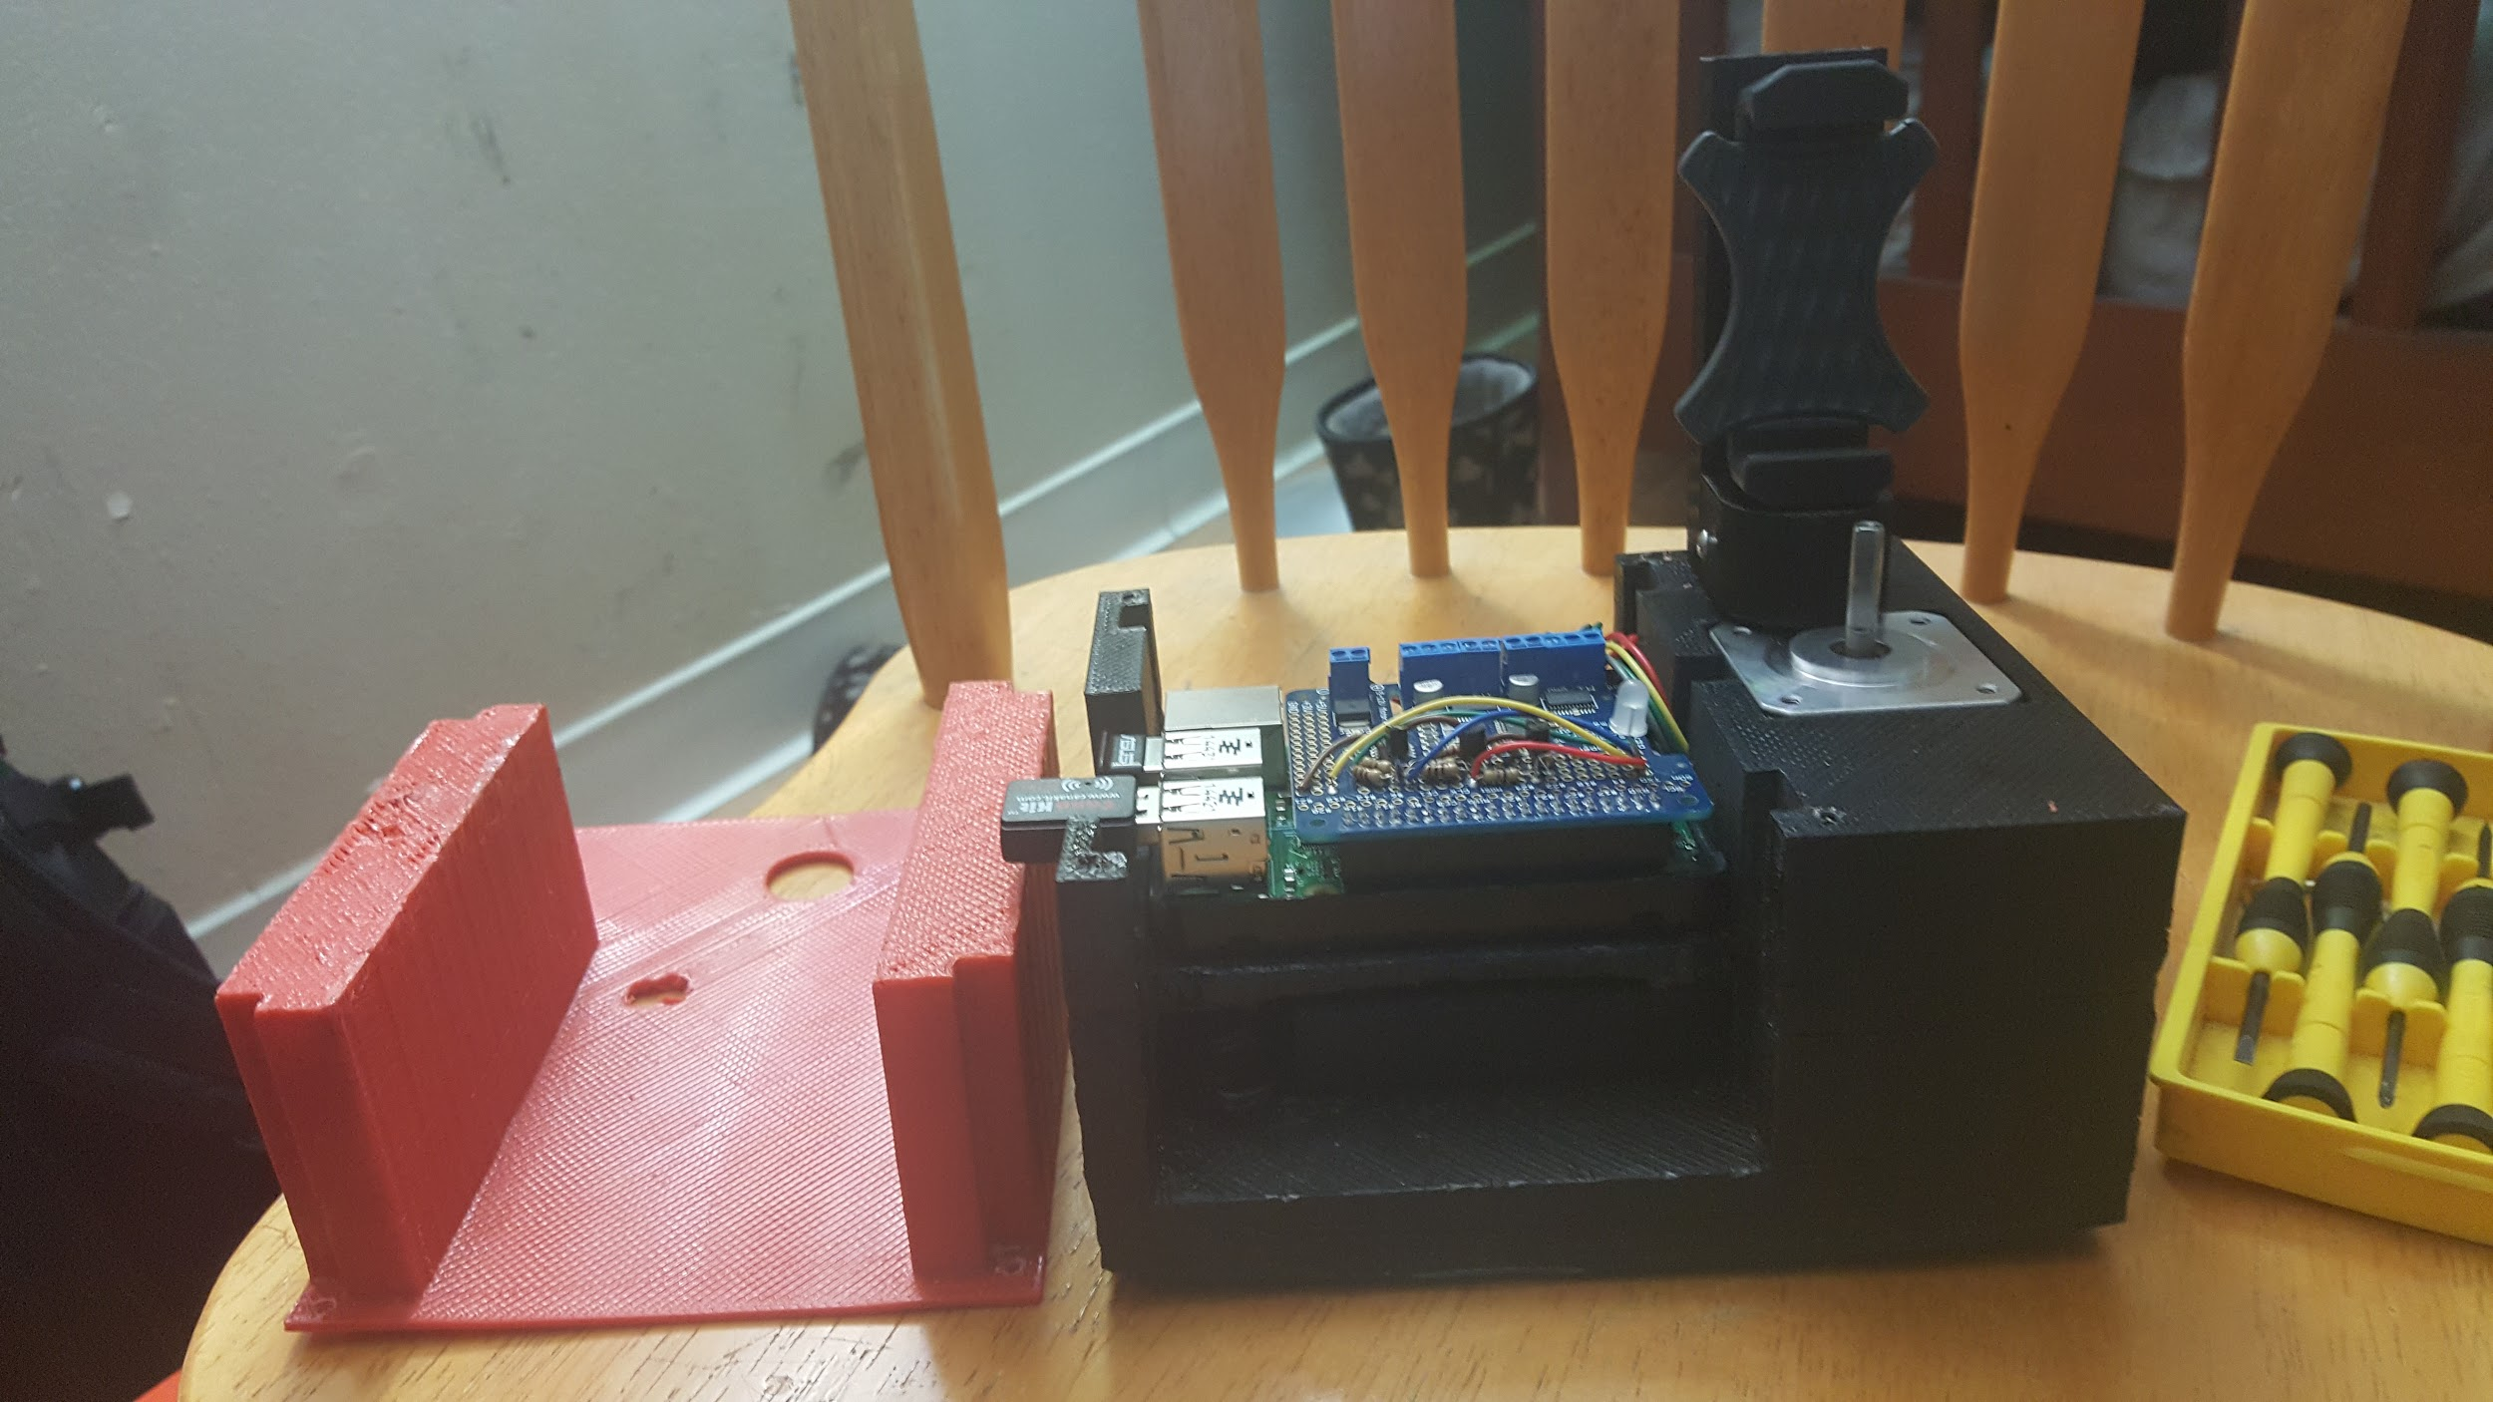
Want to build Tracker Camera?
Hardware | Cost
Raspberry Pi Model B | $ 39.99
Adafruit Board | $22.50
Stepper Motor - NEMA- 17 Size 200 steps/rev, 12v 350mA | $14.99
5v Battery pack (4 Triple A Batteries) & Female Adapter | $5.00
ABS Filament | $10.00 per roll
Folger Tech 3D Cloner (3D Printer) | $Too much. Have a friend do it.
Phone Clamp | $14.99
RGB LED | $3.49
ASUS Bluetooth Dongle | $13.99
Android Device | $ Most devices...
Resistors, Wires and Transistors | $10.00
Total: | $134.95 +

Slide 5
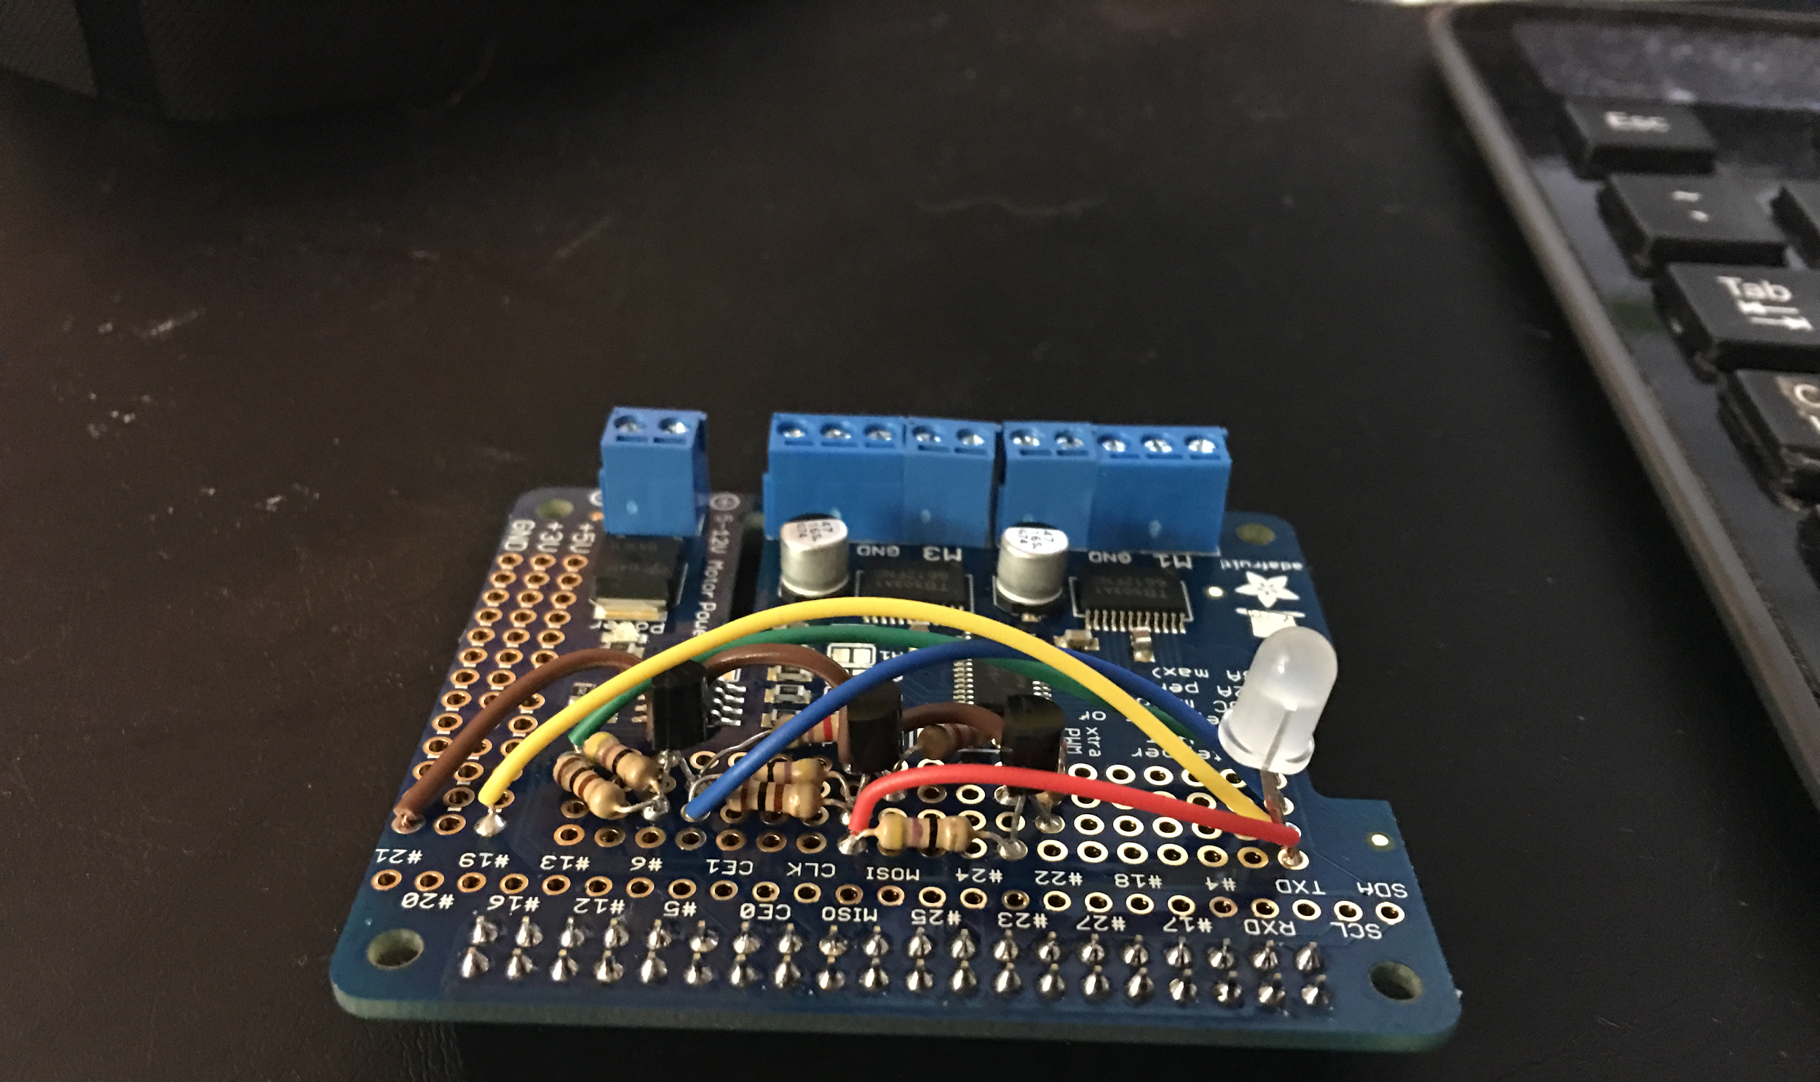
Raspberry Pi Process
Requirement
Raspberry Pi functionalities
Priorities
Design
Raspberry Pi software components
Design Circuit for LED
Overall look
Assemble Hardware
Construct LED circuit
Solder to Adafruit board
LED Circuit
2x20 plain header for GPIO
Terminal blocks
Connect wires to respective headers
Battery Pack & Stepper Motor,
Implement code
Testing
Bluetooth connectivity
Different LED colors
Different steps for stepper Motor.
Integration
Combine Android Device and Raspberry Pi for testing.
Model
Android Device holder for motor shaft
Case for Raspberry Pi
1. Requirements
Research the libraries used to move stepper motor, receive information via bluetooth, light up the LED light and OnShape for 3D Modeling. Abel
2. Design
3. Assemble Hardware
4. Implement
Research
5. Testing
6. Integration
7. Model
Notes:
Rc.local file and the ‘&’
Different Steps -> Single Steps, Double Steps ,Interleaved Steps, Microstepping

Slide 6





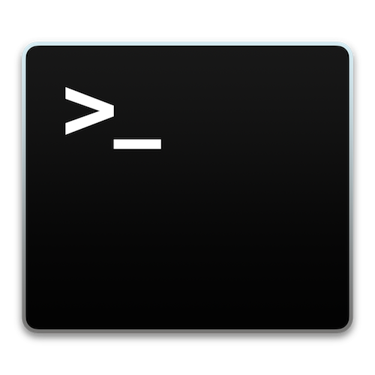
Technologies for Raspberry Pi
Model: Raspberry Pi 2 Model B
OS: Raspbian is a free operating system based on Debian, which is optimized for the Raspberry Pi
Text Editor: LeafPad and Nano (Terminal)
Programming Language: Python 2.7 (Raspberry Pi) / Java (Android)
Hardware Interface Board: Adafruit DC & Stepper Motor HAT for Raspberry Pi
Modeling Tools: Maya & Onshape
Hardware Interface Libraries:
RPi.GPIO from python.org
PyBluez from https://pypi.python.org/pypi/PyBluez
Adafruit_MotorHAT.py by Adafruit https://learn.adafruit.com/adafruit-dc-and-stepper-motor-hat-for-raspberry-pi/using-stepper-motors
Adafruit_PWM_Servo_Driver.py by Adafruit
I2C tutorial by Adafruit https://learn.adafruit.com/adafruits-raspberry-pi-lesson-4-gpio-setup/configuring-i2c
Notes:
PyBlues: mention it was easier to install on Window than on Mac
I2C port unlocking

Slide 7
Android Application Process
Requirements
QA Test
Failure
Add Task To Sprint
Implementation
Quality Assurance
Design
Successful Review
Code coverage
> 80%
Successful
Review
QA tests
Pass
Design
Completed
Failed Review
Code Review
Maintenance
Design Review

Slide 8



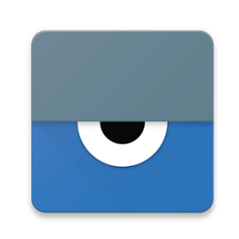
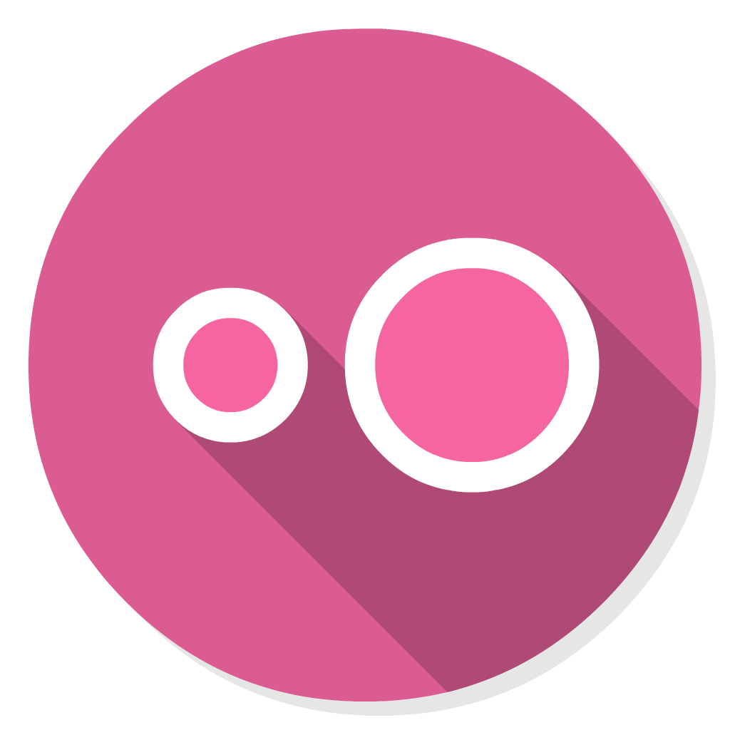
Android Application Technology Usage
Android Studio
Taiga
GitHub
Vysor
Genymotion

Slide 9
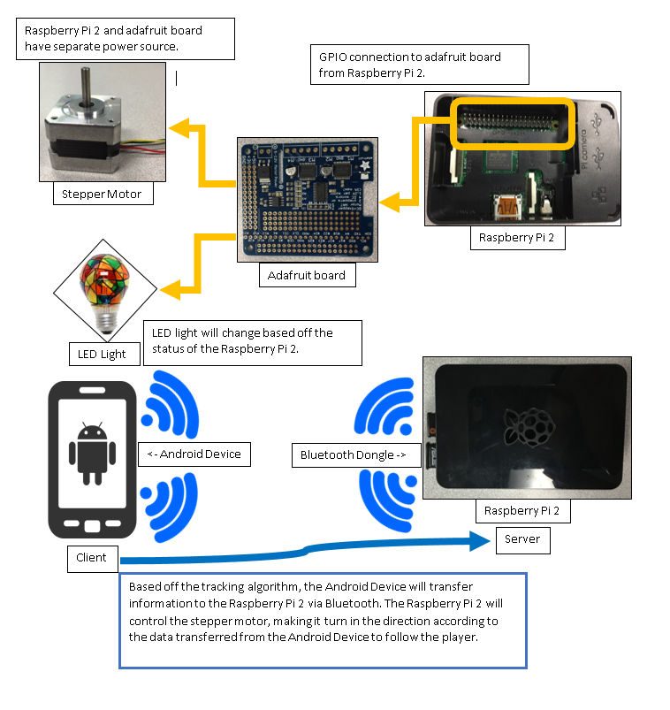
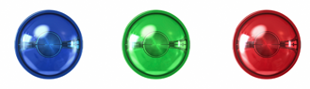
Tracker Camera Application Flow
Raspberry Pi
Bluetooth
Motor
LED
Android App
User Interface
Video Recording
Video Save List
Algorithm
Centroid
Tracking
Raspberry Pi
Android App
Video Gallery
Algorithm
/ Solid
/ Solid
Blinking
Blinking
Blinking

Slide 10
Raspberry Pi Reflection
What went well?
Communication
Assembly of Hardware
Pair Programming
Organization
What went wrong?
Rc.local editing and constant reset loop
Finding how to change root files from read only to read and write
LED Thread for constant blinking
What would we do differently?
Use GitHub more often to avoid these problems
Use Flooby https://floobits.com/

Slide 11
Android Application Reflection
What went well
Enthuastic about the assignment
No intra-group conflicts
Integrity
Trust
Group adapted to difficult circumstances
Everyone accomplished their tasks
Exellent prioritization of tasks
What went wrong
Spent too much time on process
Poor communication between android app team members
Insufficient research on available computer vision libraries before coding
Poor, inconsistent use of available tools (Git, Taiga, and TravisCI)

Slide 12
Overall Group Reflection
Lessons we learned
Be very careful with version control and backups
Research thoroughly and early
Recognize dead-ends in a timely manner
3rd-party tools can greatly expedite a project, but they also come with limitations that might not have been expected
Future iterations
Refractor code to improve class and module cohesion
Make UI friendlier
Add file tagging system
Add vertical axis of motion
Add multicolor pattern tracking
Enhanced image recognition

Slide 13
Special Thanks
!!! Jose Vergara for Soldering and 3D printing !!!

